Slide 1

Close the loop in CDS in 10 steps
Ammar Al-Jodah

Slide 2
Content
Step 1
IOP and open loop mdl file
Step 6
Matlab, Simulink control system design and simulation
Step 2
Build, install, start of realtime code local_dc start
Step 7
Closed loop mdl file
Step 3
diaggui step response
Step 8
Build, install, start of realtime code local_dc start
Step 4
diaggui find transfer function
Step 9
Foton, define the controller filter
Step 5
Export data to matlab, find the transfer function equation
Step 10
diaggui step response

Slide 3



Software used
diaggui
Foton
Ndscope

Slide 4
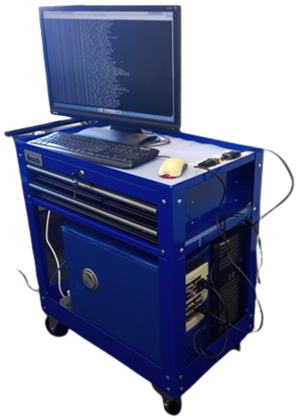
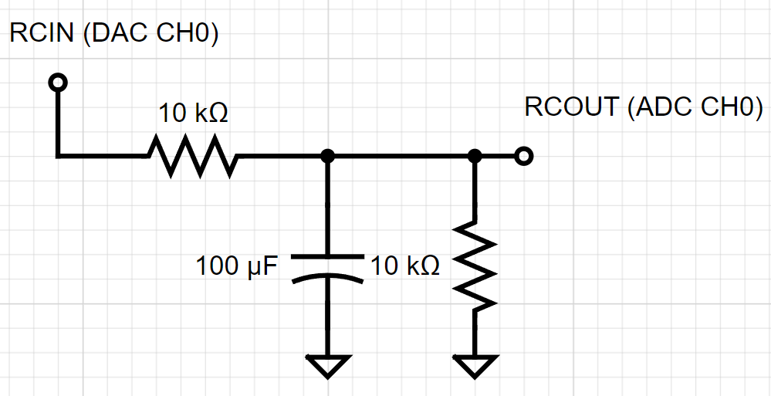
Hardware used
FE and Extension box holds the Cards: ADC, DAC on a PCIe bus
RC circuit

Slide 5
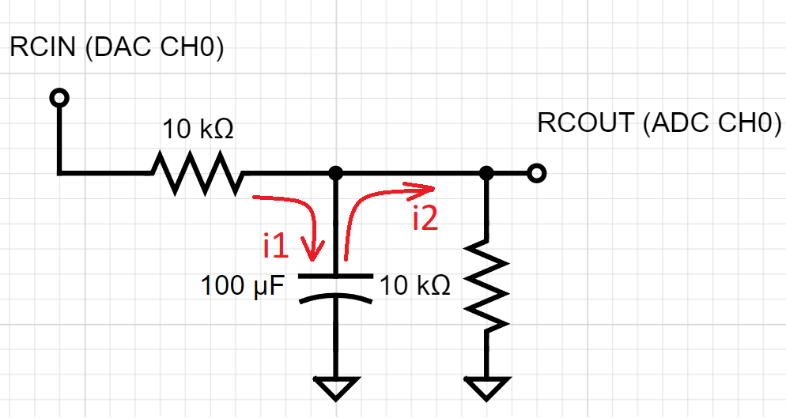
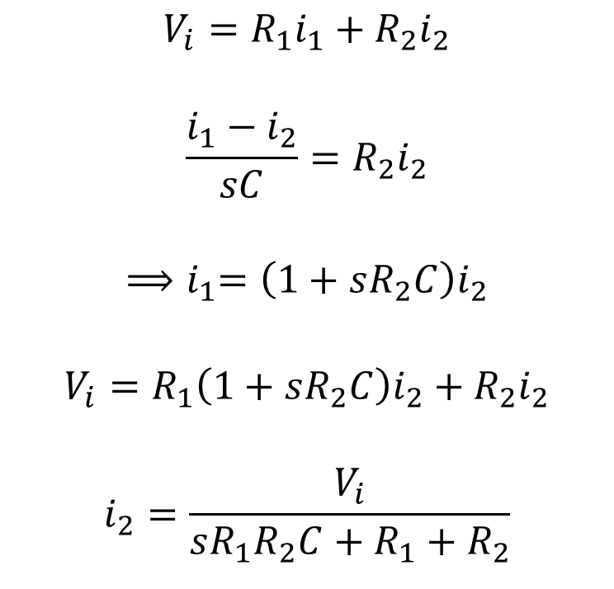
RC circuit theoretical modelling
$$V_{i}=R_{1}i_{1}+R_{2}i_{2}$$
$$\frac{i_{1}−i_{2}}{sC}=R_{2}i_{2}$$
$${⟹i}_{1}=\left(1+sR_{2}C\right)i_{2}$$
$$V_{i}=R_{1}\left(1+sR_{2}C\right)i_{2}+R_{2}i_{2}$$
$$i_{2}=\frac{V_{i}}{sR_{1}R_{2}C+R_{1}+R_{2}}$$
R1
Vi
Vo
C
R2

Slide 6
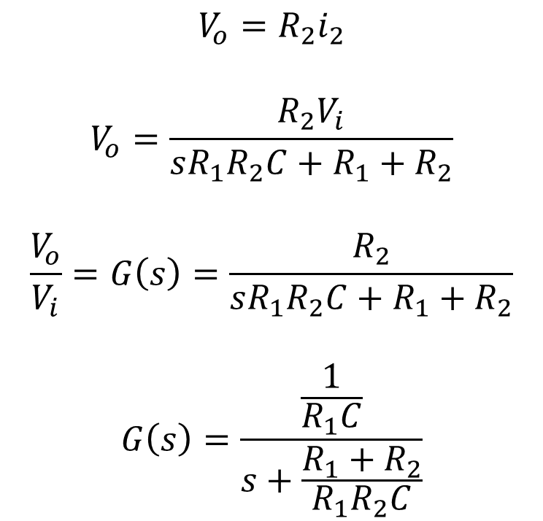
RC circuit theoretical modelling
$$V_{o}=R_{2}i_{2}$$
$$V_{o}=\frac{R_{2}V_{i}}{sR_{1}R_{2}C+R_{1}+R_{2}}$$
$$\frac{V_{o}}{V_{i}}=G\left(s\right)=\frac{R_{2}}{sR_{1}R_{2}C+R_{1}+R_{2}}$$
$$G\left(s\right)=\frac{\frac{1}{R_{1}C}}{s+\frac{R_{1}+R_{2}}{R_{1}R_{2}C}}$$
R1
Vi
Vo
C
R2

Slide 7
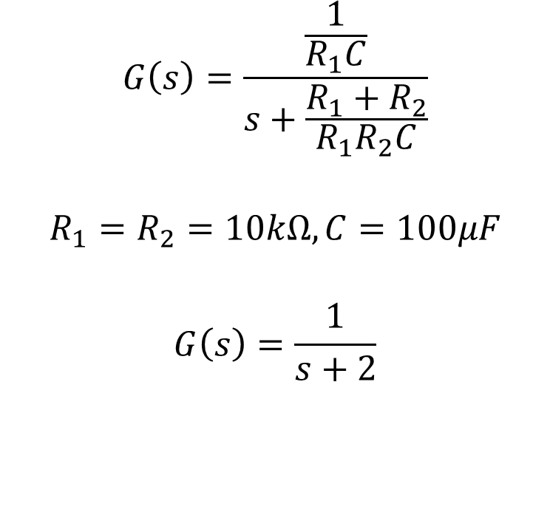
RC circuit theoretical modelling
$$G\left(s\right)=\frac{\frac{1}{R_{1}C}}{s+\frac{R_{1}+R_{2}}{R_{1}R_{2}C}}$$
$$R_{1}=R_{2}=10kΩ, C=100μF$$
$$G\left(s\right)=\frac{1}{s+2}$$
R1
Vi
Vo
C
R2

Slide 8
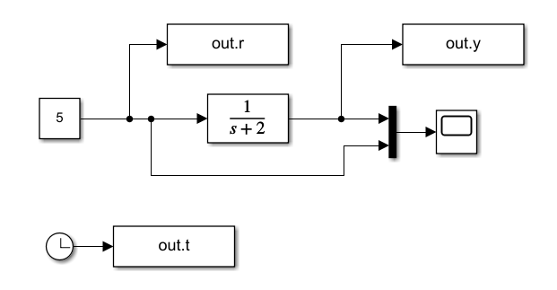
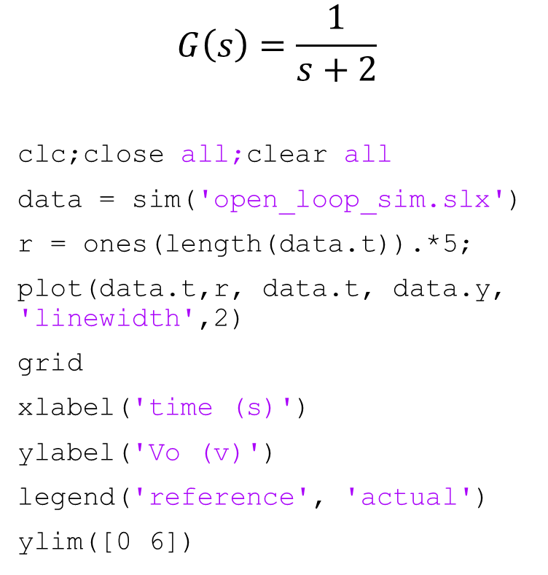
Open-loop simulation
$$G\left(s\right)=\frac{1}{s+2}$$
clc;close all;clear all
data = sim('open_loop_sim.slx')
r = ones(length(data.t)).*5;
plot(data.t,r, data.t, data.y, 'linewidth',2)
grid
xlabel('time (s)')
ylabel('Vo (v)')
legend('reference', 'actual')
ylim([0 6])
open_loop_sim.slx
openloop_step.m

Slide 9
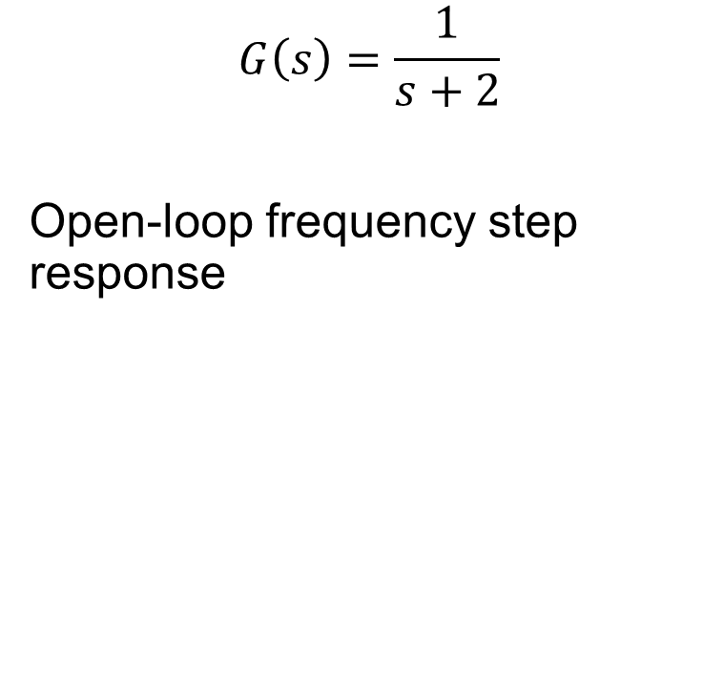
Open-loop simulation
$$G\left(s\right)=\frac{1}{s+2}$$
Open-loop frequency step response

Slide 10
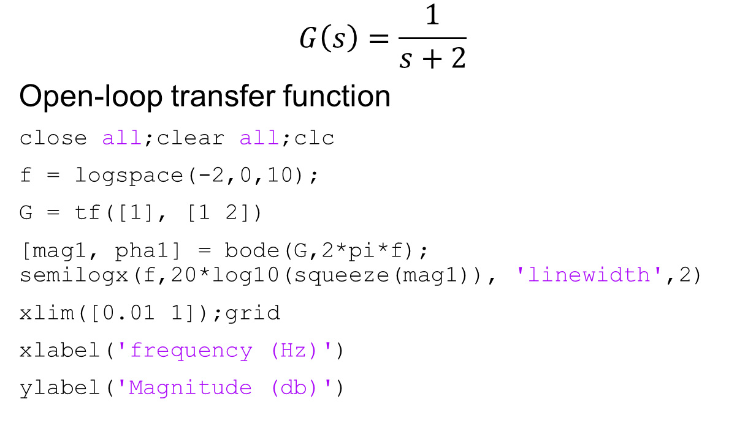
Open-loop simulation
$$G\left(s\right)=\frac{1}{s+2}$$
Open-loop transfer function
close all;clear all;clc
f = logspace(-2,0,10);
G = tf([1], [1 2])
[mag1, pha1] = bode(G,2*pi*f); semilogx(f,20*log10(squeeze(mag1)), 'linewidth',2)
xlim([0.01 1]);grid
xlabel('frequency (Hz)')
ylabel('Magnitude (db)')
openloop_freq_resp.m

Slide 11
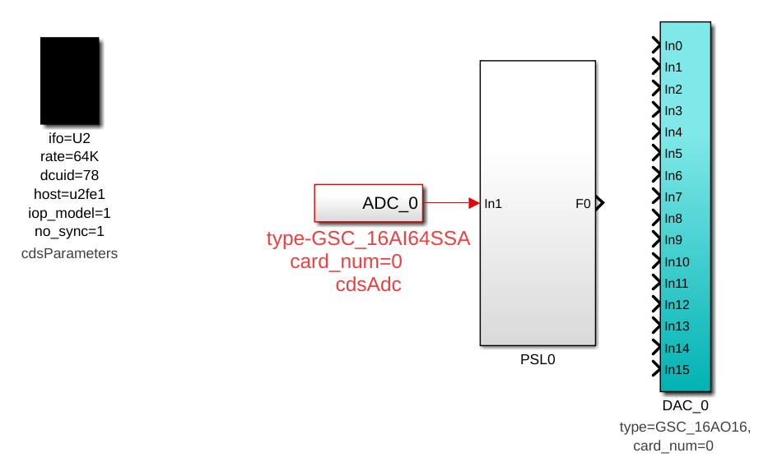
Step 1: IOP and open loop mdl
IOP stored at /opt/rtcds/usercode

Slide 12
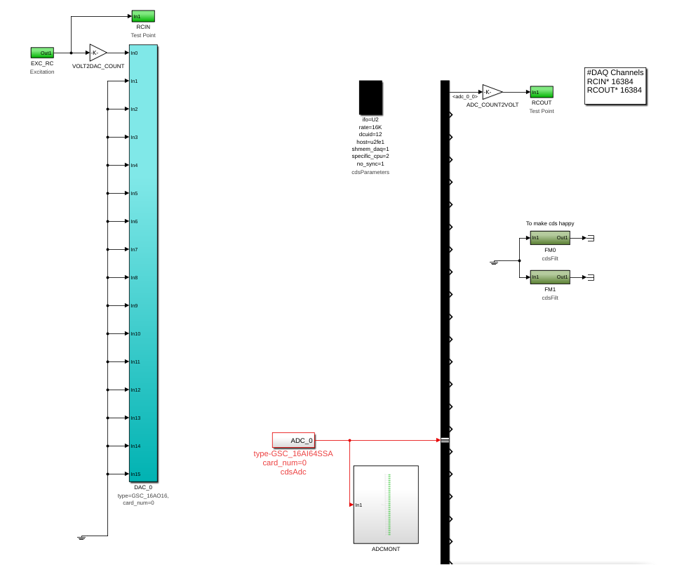
Step 1: IOP and open loop mdl
Open loop

Slide 13
Step 2: Build, install, start IOP, and Openloop mdl
Build + Install
$ rtcds build u2iop
$ rtcds install u2iop
$ rtcds build u2rcsys
$ rtcds install u2rcsys

Slide 14
Step 2: Build, install, start IOP, and Openloop mdl
Change master file
$ sudo nano /etc/advligorts/master
Add the following
/opt/rtcds/uwa/u2/chans/daq/U2IOP.ini
/opt/rtcds/uwa/u2/chans/daq/U2RCSYS.ini
/opt/rtcds/uwa/u2/target/gds/param/tpchn_u2iop.par
/opt/rtcds/uwa/u2/target/gds/param/tpchn_u2rcsys.par
ctrl+o, enter, ctrl+x

Slide 15
Step 2: Build, install, start IOP, and Openloop mdl
Change test point file
$ sudo nano /etc/advligorts/testpoint.par
Add the following
[U-node12]
hostname=u2fe1
system=u2rcsys
[U-node78]
hostname=u2fe1
system=u21iop
ctrl+o, enter, ctrl+x

Slide 16
Step 2: Build, install, start IOP, and Openloop mdl
Start models and local dc
$ rtcds start u2iop
$ rtcds start u2rcsys
$ local_dc -s u2rcsys -d /opt/rtcds/uwa/u2/target/gds/param/
If more than one model to be run, you need to put their names here

Slide 17
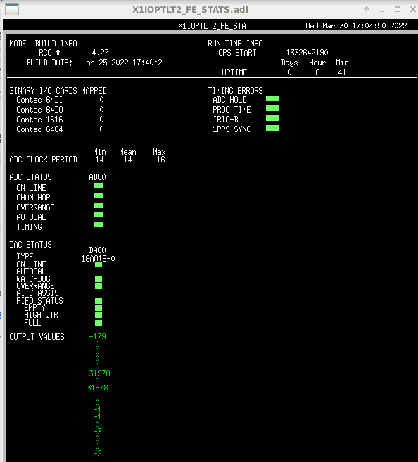
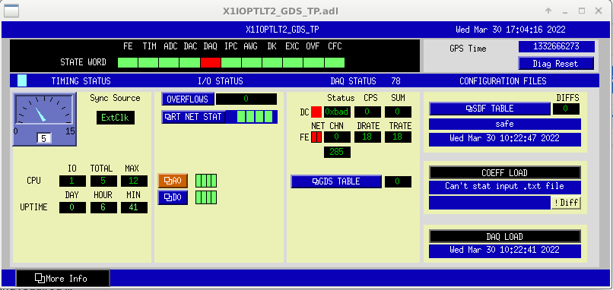
Step 2: Build, install, start IOP, and Openloop mdl
Open Global Diagnostics Screen (GDS)
$ cd /opt/rtcds/uwa/u2/medm/u2iop
$ medm U2IOP_GDS_TP.adl

Slide 18
Step 2: Build, install, start IOP, and Openloop mdl
Open U2RCSYS Global Diagnostics Screen (GDS)
$ cd /opt/rtcds/uwa/u2/medm/u2rcsys
$ medm U2RCSYS_GDS_TP.adl

Slide 19
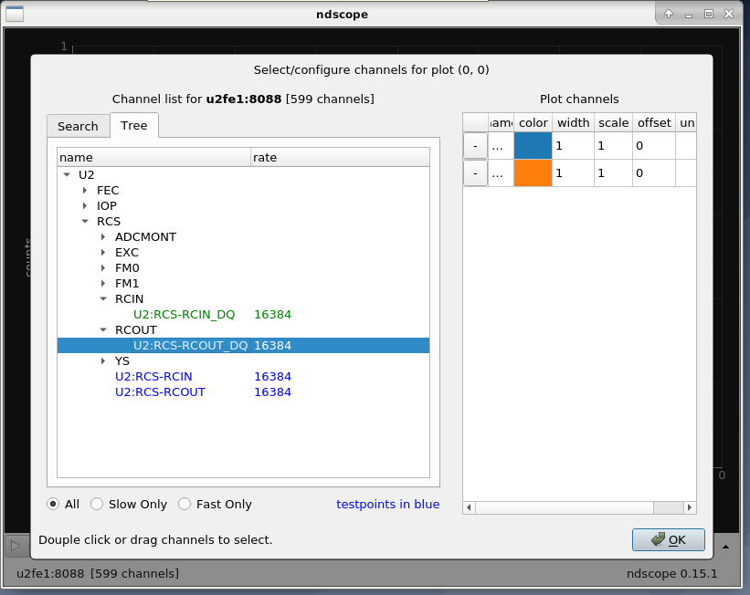
Step 2: Build, install, start IOP, and Openloop mdl
Start ndscope
$ NDSSERVER=u2fe1:8088 ndscope
Select the channels

Slide 20
Step 3: diaggui: open-loop step response
Start diaggui
$ NDSSERVER=u2fe1:8088 LIGO_RT_BCAST=u2fe1 diaggui -v

Slide 21
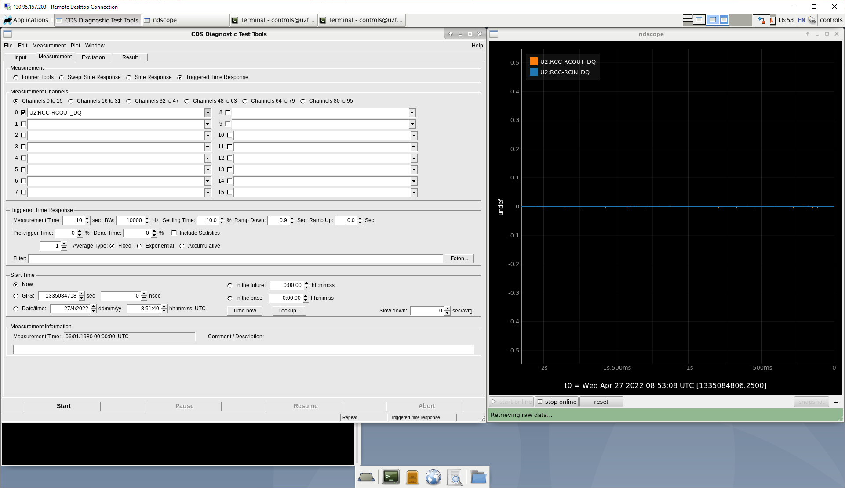
Step 3: diaggui: open-loop step response

Slide 22
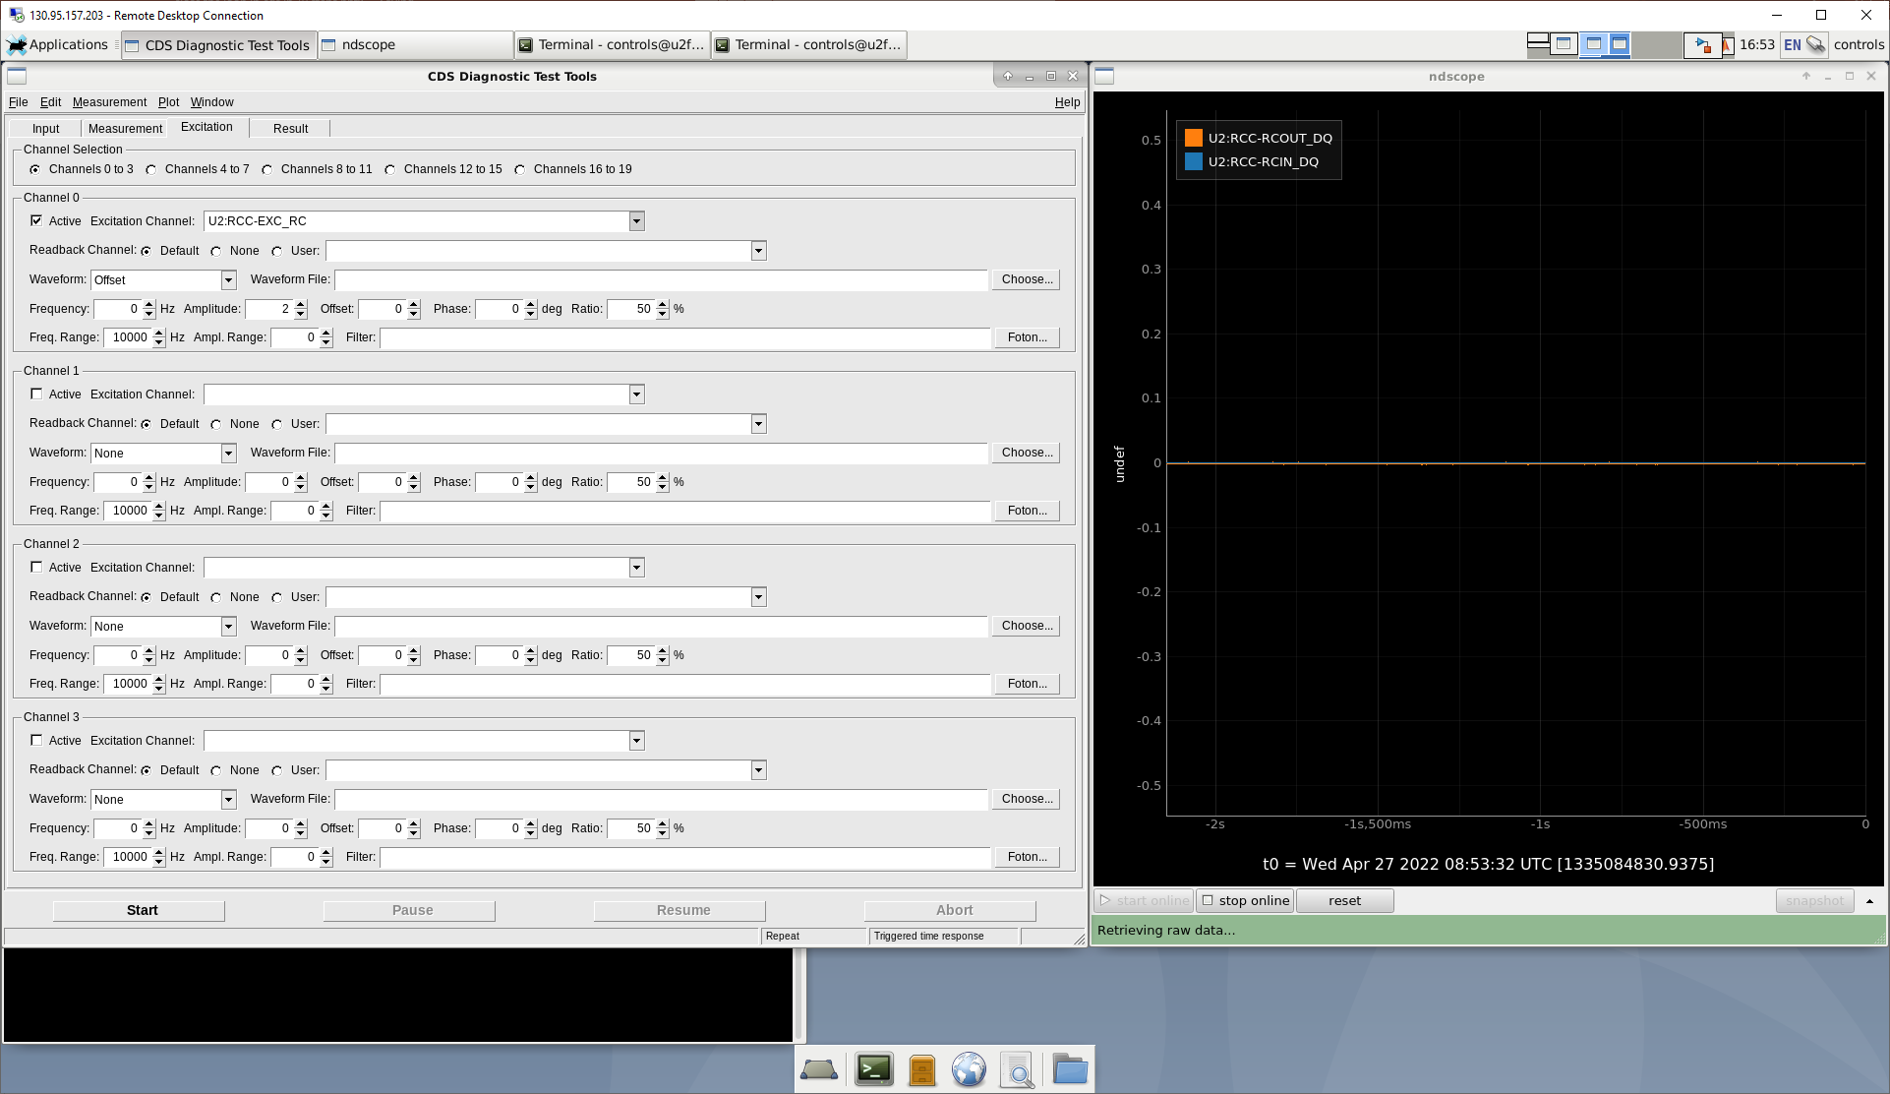
Step 3: diaggui: open-loop step response

Slide 23
Step 4: diaggui: finding transfer function
Start diaggui
$ NDSSERVER=u2fe1:8088 LIGO_RT_BCAST=u2fe1 diaggui -v

Slide 24
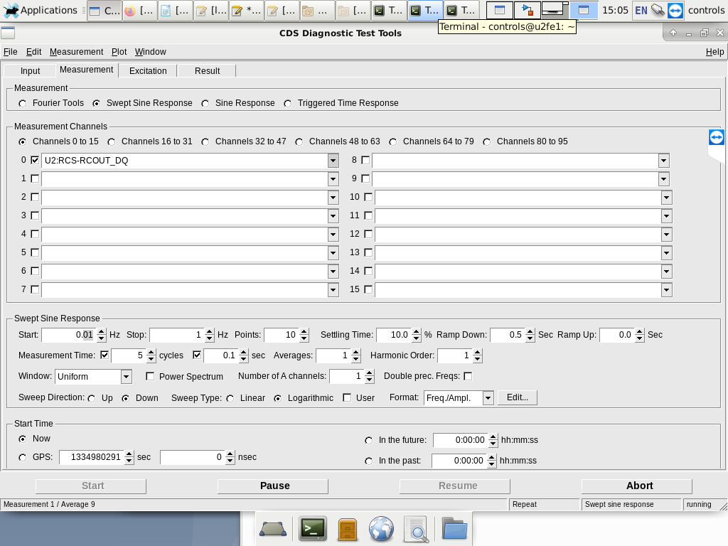
Step 4: diaggui: finding transfer function
Select the measurement signal
Set Swept sine settings

Slide 25
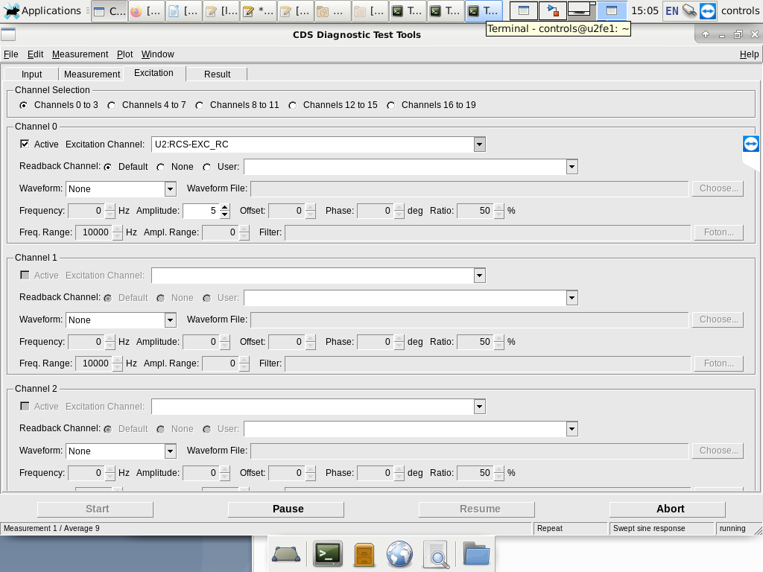
Step 4: diaggui: finding transfer function
Select the excitation signal
Set the amplitude

Slide 26
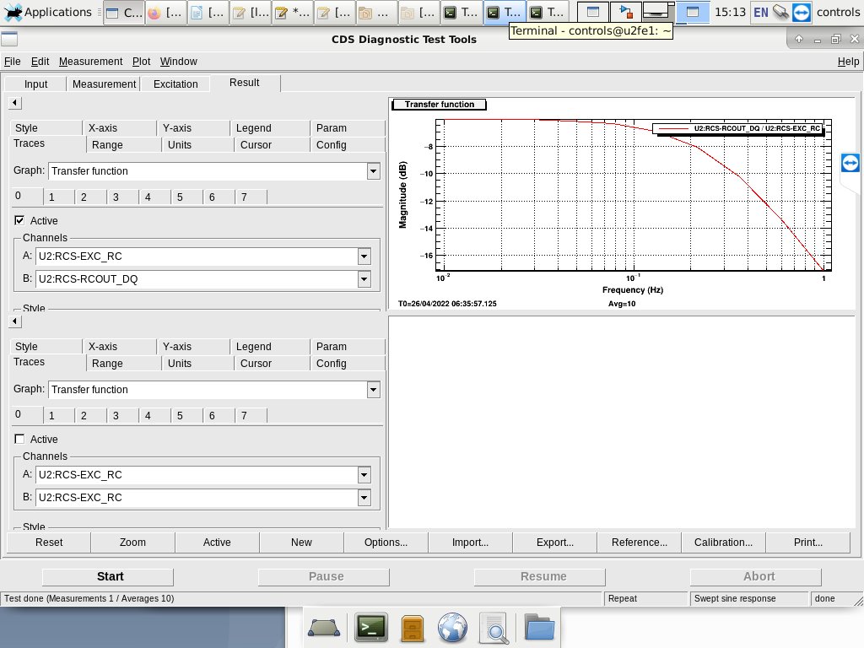
Step 4: diaggui: finding transfer function
Start
Export results

Slide 27
Step 5: sysident: transfer function fitting
Exported data
0.0099999998 -6.0167427 -2.1172364
0.016681006 -6.0351129 -3.5013008
0.027825594 -6.0723886 -5.7871747
0.046415888 -6.1603427 -9.5233917
0.077426367 -6.38203 -15.495438
0.12915497 -6.9235191 -24.538395
0.21544346 -8.1057043 -36.789986
0.35938138 -10.248335 -50.551247
0.59948426 -13.35558 -62.882248
1 -17.113218 -72.070374
Plot with experimental transfer function with the model

Slide 28
Step 5: sysident: transfer function fitting
Matlab code to plot
clc;close all;clear all
file_name = 'data.txt';
data = importdata(file_name);
f = data(:,1);
mag2 = data(:,2);
pha2 = data(:,3);
G = tf([1], [1 2])
[mag1, pha1] = bode(G,2*pi*f);
figure(1)
semilogx(f,20*log10(squeeze(mag1)), 'linewidth',2)
xlim([0.01 1])
grid
hold on
semilogx(f,mag2, 'linewidth',2)
legend('model', 'experiment')
xlabel('frequency (Hz)')
ylabel('Magnitude (db)')
figure(2)
semilogx(f,squeeze(pha1), 'linewidth',2)
xlim([0.01 1])
grid
hold on
semilogx(f,pha2, 'linewidth',2)
legend('model', 'experiment')
xlabel('frequency (Hz)')
ylabel('Phase (deg)’)
mag_abs = 10.^(mag2/20);
w = 2*pi*f;
T = 1/16384;
compare_theoretical_model_exp.m
Used for the sysident

Slide 29
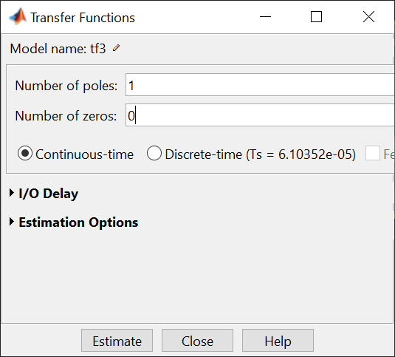
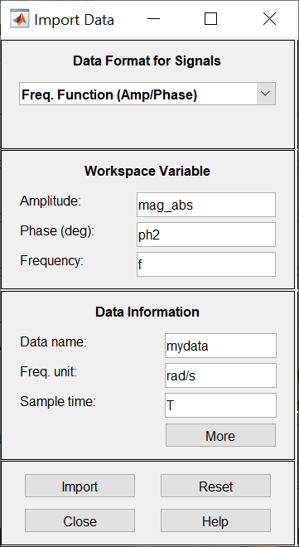
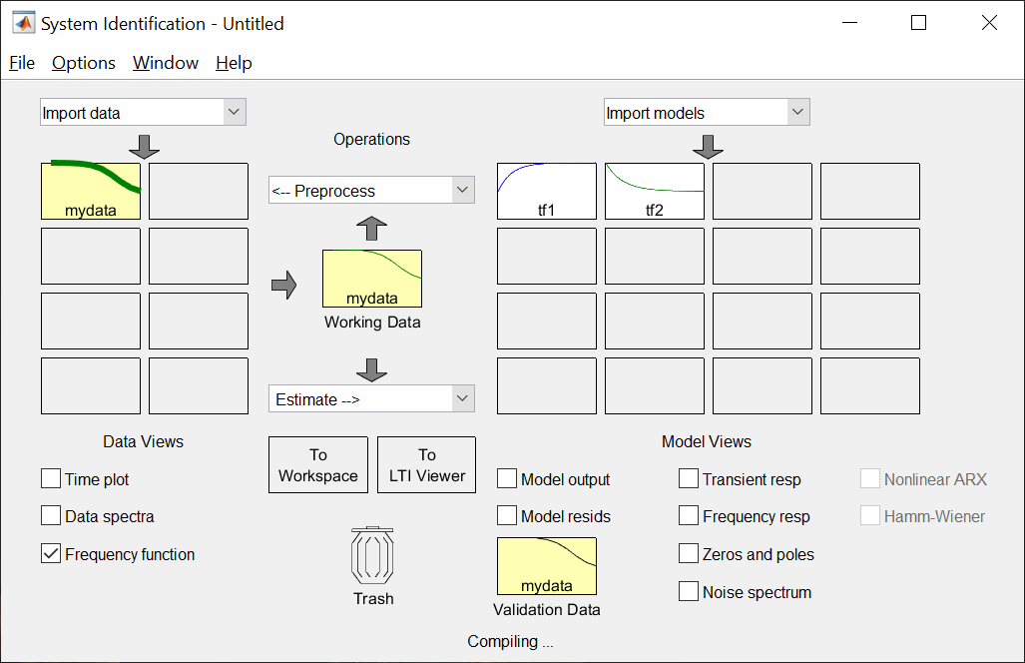
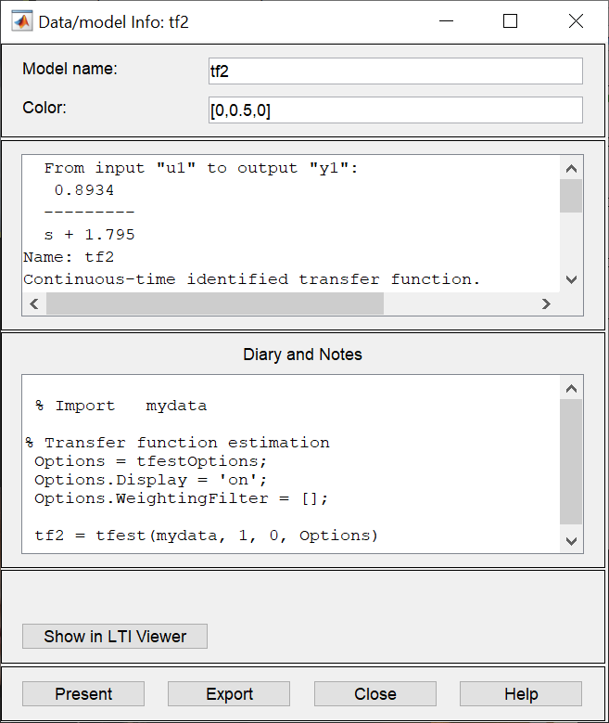
Step 5: sysident: transfer function fitting
Setup sysident to fit the transfer function

Slide 30
Step 5: sysident: transfer function fitting
Comparing the results
compare_fit_model_exp.m

Slide 31
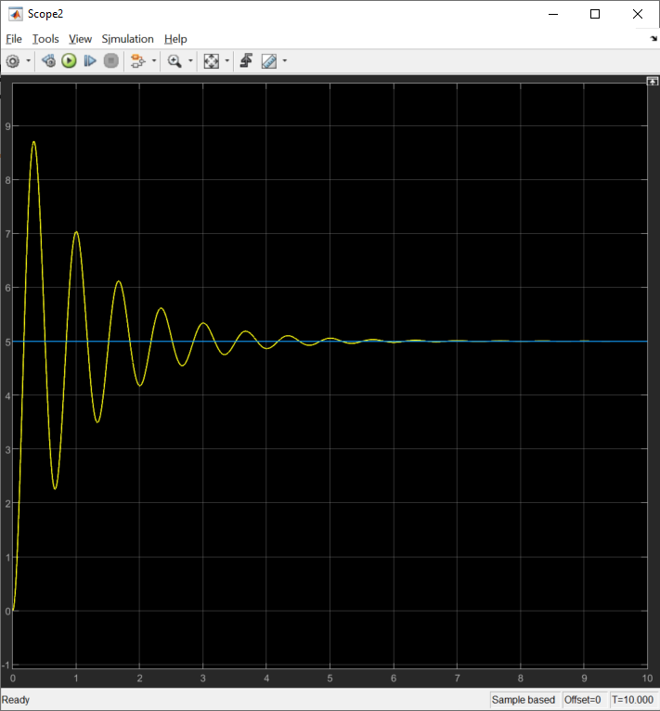
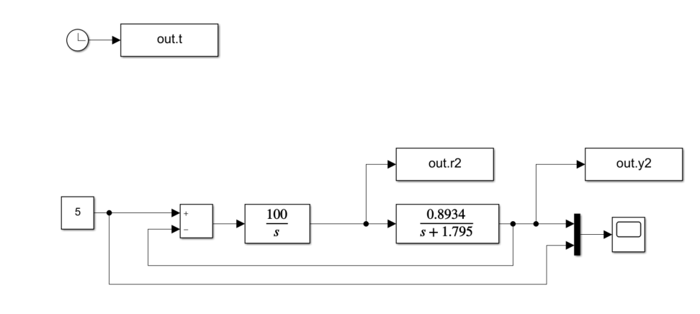
Step 6: Matlab, Simulink: controller design

Slide 32
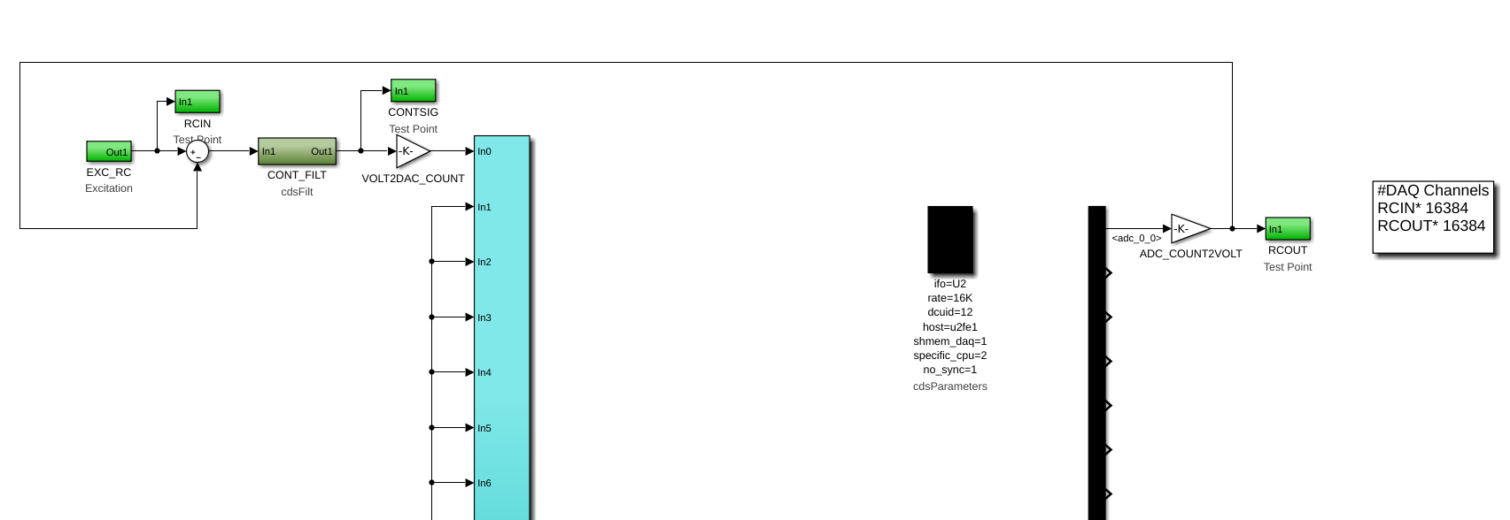
Step 7: closed-loop mdl

Slide 33
Step 8: Build, install, start IOP, and Openloop mdl
Same as step 2 but the local dc should have the new model name
$ local_dc -s u2rccl -d /opt/rtcds/uwa/u2/target/gds/param/
If you want to have the closed loop model on the same node then you need to edit the file /opt/rtcds/uwa/u2/target/gds/param/testpoint.par and remove the old model at the same node number

Slide 34
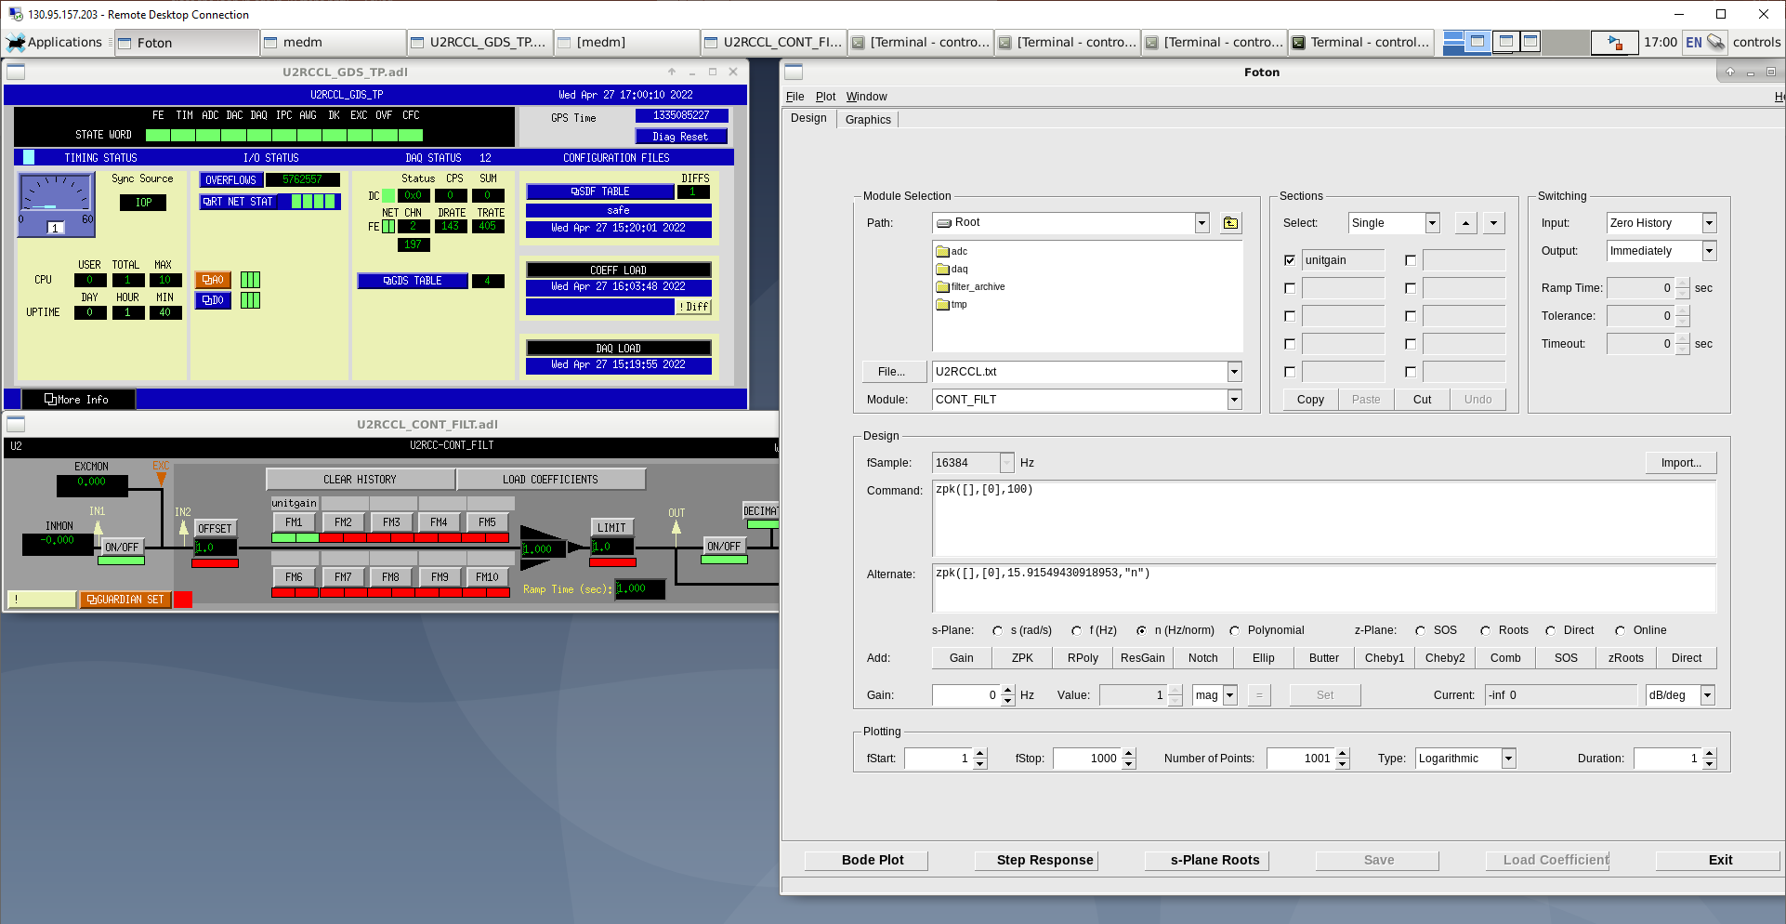
Step 9: Foton: filter design
/opt/rtcds/uwa/u2/chans

Slide 35
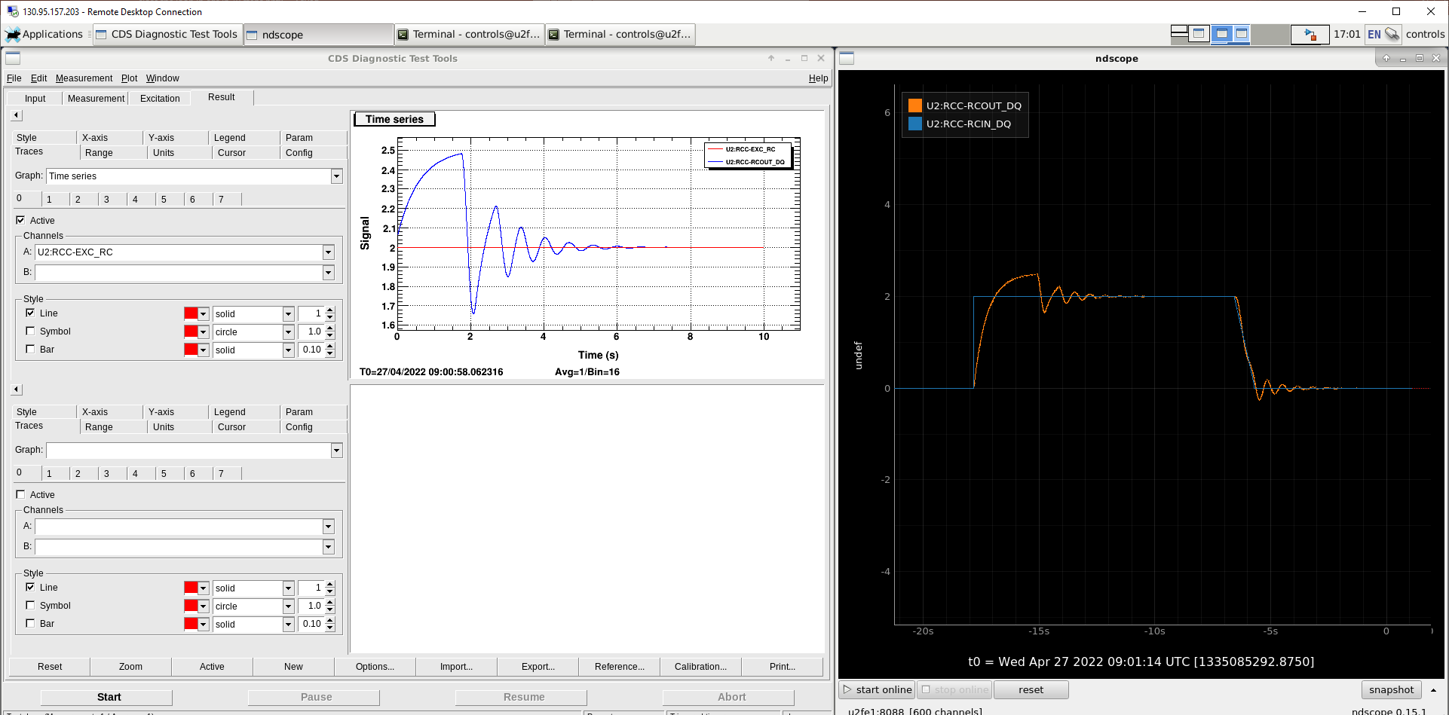
Step 10: diaggui: closed-loop step response

Slide 36
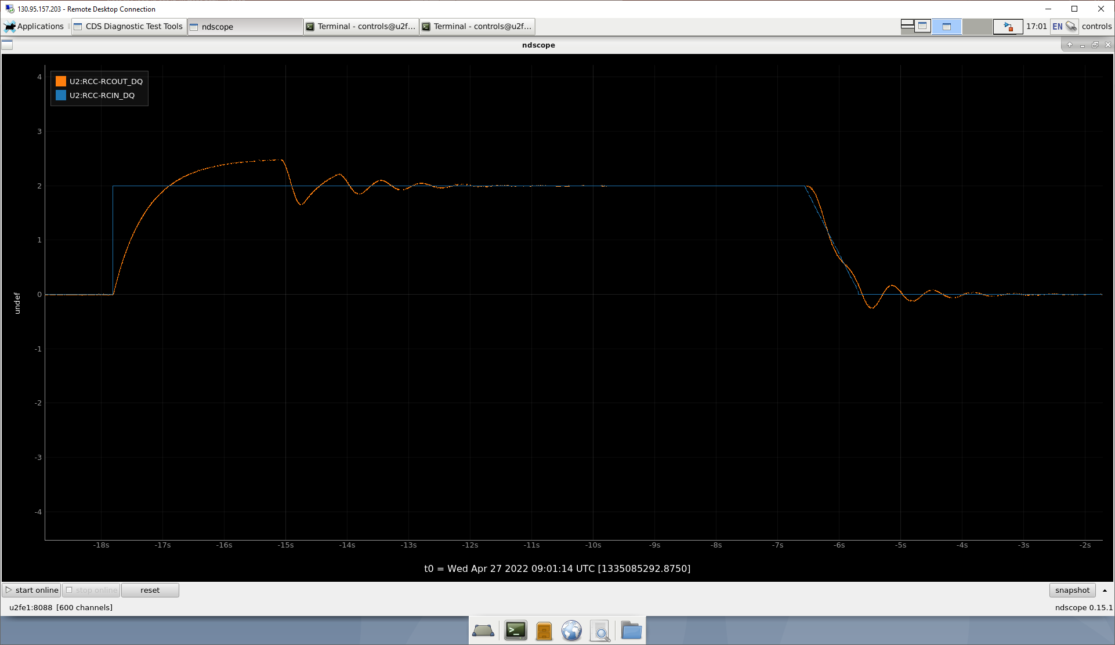
Step 10: diaggui: closed-loop step response

Slide 37
Thank you

